Slide 1
Chapter 2 Configuration Space
2.1 DOF of a Rigid Body
2.2 DOF of a Robot
2.3 C-space Topology and Representation
Chapter 3 Rigid-Body Motions
Chapter 4 Forward Kinematics
Chapter 5 Velocity Kinematics and Statics
Chapter 6 Inverse Kinematics
Chapter 7 Kinematics of Closed Chains
Chapter 8 Dynamics of Open Chains
Chapter 9 Trajectory Generation
Chapter 10 Motion Planning
Chapter 11 Robot Control
Chapter 12 Grasping and Manipulation
Chapter 13 Wheeled Mobile Robots

Slide 2
Important concepts, symbols, and equations
Two C-spaces may have the same dof but differ in other ways. The topology (“shape”) of a space is independent of how we represent it.
Two spaces are topologically equivalent if one can be continuously deformed to the other without cutting or pasting.
Some spaces are Cartesian products of spaces of lower dimension, e.g.,
(1d) 𝔼, S = T (2d) 𝔼 × 𝔼 = 𝔼², S × S = T², S², 𝔼 × S (higher) 𝔼^{k} × S^{m} × T^{n}
Represent Euclidean (“flat”) spaces 𝔼^{n} as ℝ^{n}. For curved spaces, choose
minimum-parameter explicit parameterizations (choose between singularities or an atlas of coordinate charts), OR
implicit representation (use more numbers subject to constraints).

Slide 3
Any value in an atlas of coordinate charts?
An implicit representation?
Any value in an atlas of coordinate charts?
An implicit representation?
Any value in an atlas of coordinate charts?
An implicit representation?

Slide 4





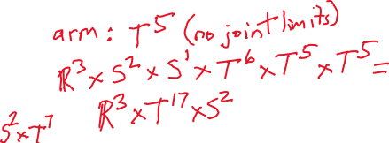

C-space topology, with and without
arm joint limits, rotor angles?
Implicit/explicit representations?
Grübler’s formula?
hexrotor with two 5-DOF arms
https://www.prodrone.com/archives/1420/

Slide 5
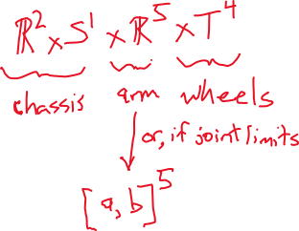

C-space topology and representation?
Include gripper, wheel angles?
KUKA youBot
mecanum-wheel omnidirectional base
moving on flat ground
plus 5-DOF robot arm + gripper

